Slide 1

Introduction to OpenCV
Presented by - Darshita Jain (MTech CSE)

Slide 2
Agenda
Basics of OpenCV
2) Applications of OpenCV
Panorama Stitching
Face and Eye Detection using Haar Cascade Classifier

Slide 3

About
OpenCV (Open Source Computer Vision Library) is an open source computer vision and machine learning software library.
The Library has more than 2500 optimized algorithms for tasks like Object detection, Image Stitching, Classify Human actions in videos etc.
The library is used extensively in companies (like Google, Yahoo, Microsoft, Intel, IBM, Sony, Honda, Toyota), research groups and by governmental bodies.
It has C++, Python, Java and MATLAB interfaces and supports Windows, Linux, Android and Mac OS.

Slide 4
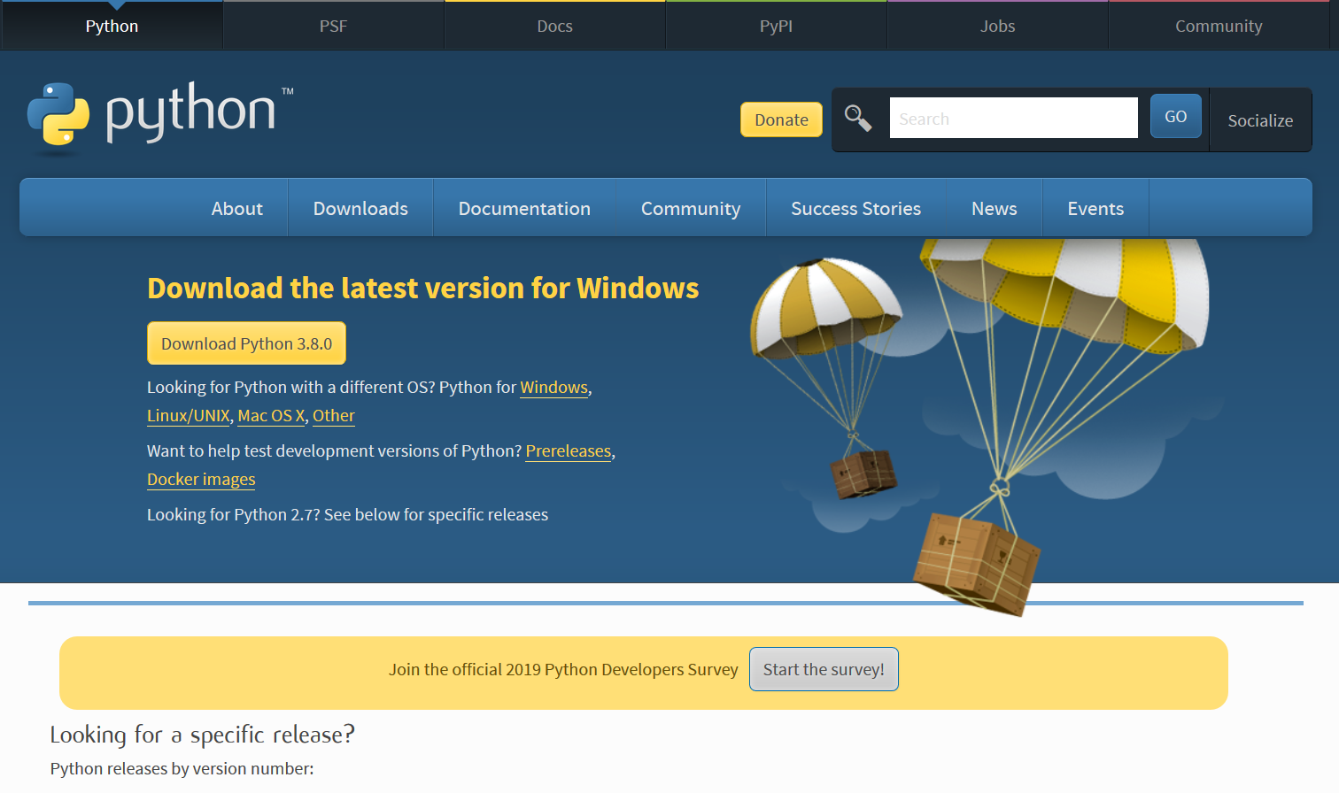
Installing Python (Windows)
https://www.python.org/downloads/

Slide 5
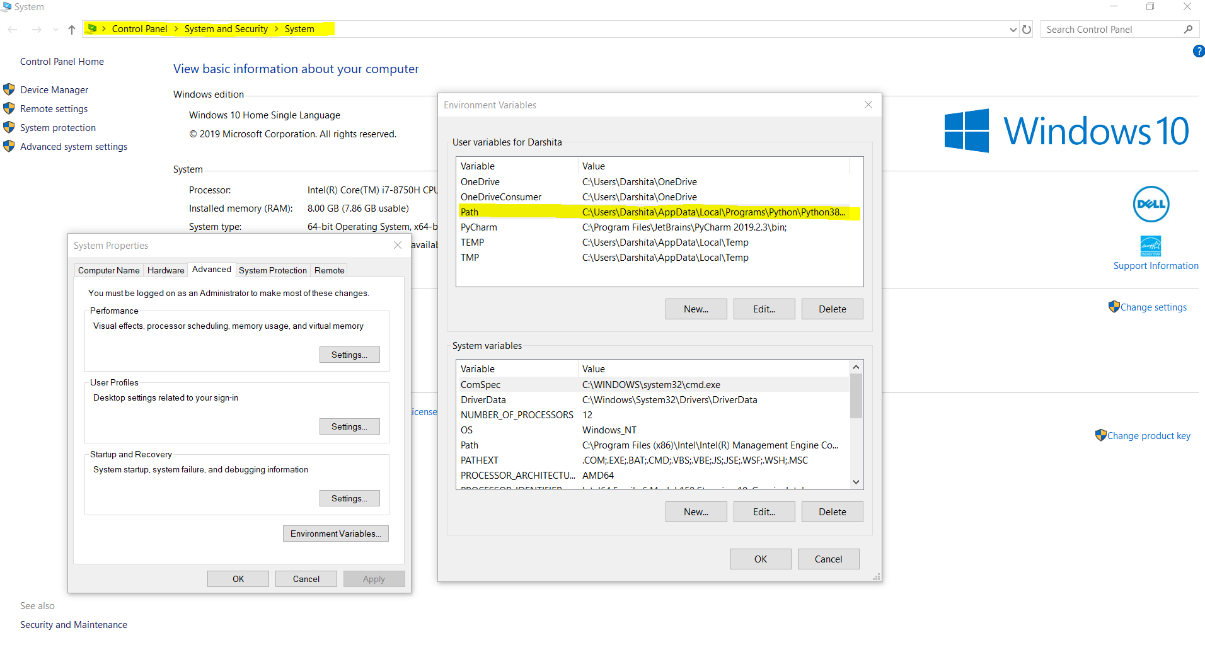
Adding Python installation path to Windows' PATH Environment Variable

Slide 6
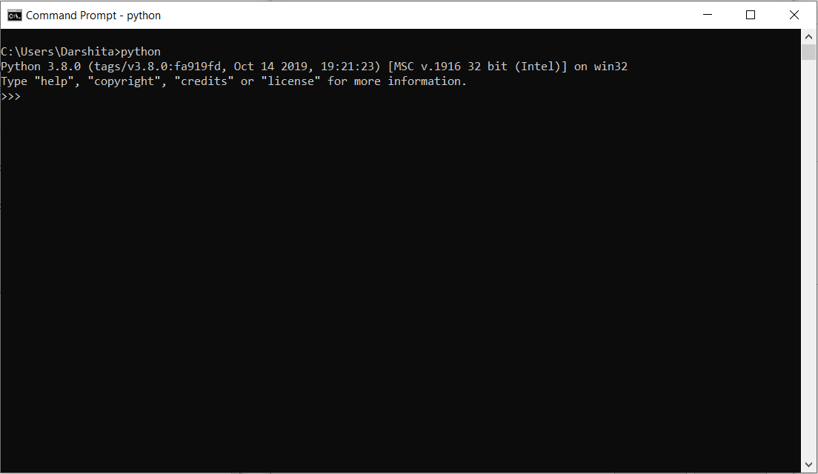

Slide 7
Installing Pip (Windows)
Download get-pip.py to a folder on your computer. Open a command prompt window and navigate to the folder containing get-pip.py. Then run python get-pip.py. This will install pip.
Detailed Installation guide is here!

Slide 8
Installing OpenCV (Windows)
Open Command Prompt and run the following command-
pip install opencv-contrib-python
Detailed guide here.
To include OpenCV library in your programs use - import cv2

Slide 9
Installing Python, pip and OpenCV in Linux(Ubuntu)
Install Python using -
sudo apt-get install python
Install pip using -
sudo apt install python3-pip
Install OpenCV -
pip install opencv-contrib-python
Guide for Ubuntu here.

Slide 10
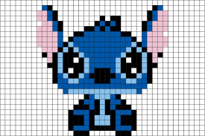
Representing an Image
Images are a matrix of pixels, where each pixel contains a value in the range 0-255 to denote the color represented by it.
Every color that can be rendered on a computer screen can be represented as a combination of Red, Green and Blue.
Eg - Red (255,0,0), Green(0, 255, 0), Blue (0, 0 , 255), Orange(255,165,0)

Slide 11
Basics of OpenCV
Reading an Image
cv2.imread command reads an Image from the given path and stores it in a form of a matrix.
Note - When the image is read with the OpenCV function imread(), the order of colors is BGR (blue, green, red).

Slide 12
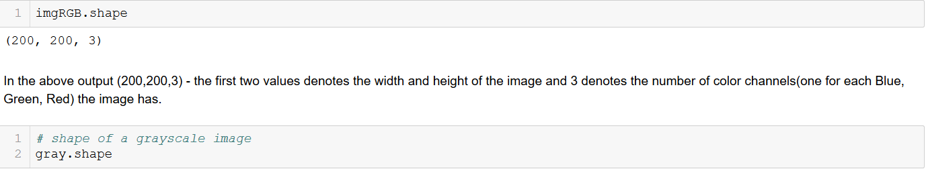
Shape of an Image

Slide 13
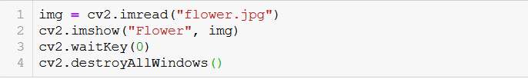
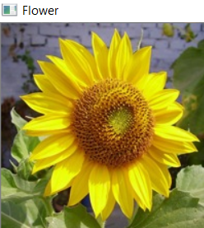
Displaying an Image

Slide 14
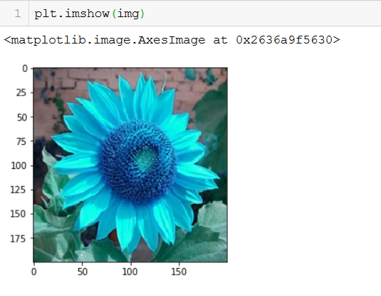
Displaying an Image using Matplotlib

Slide 15
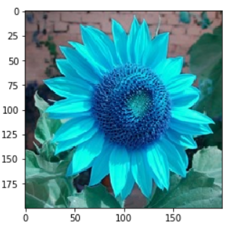
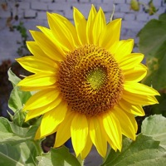
Converting BGR image into RGB image
Input BGR image
Output RGB image

Slide 16
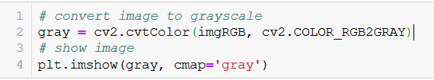
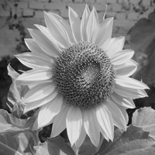
Converting RGB image into Grayscale
Input RGB Image
Output Grayscale Image

Slide 17
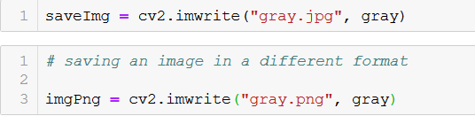
Saving an Image

Slide 18
Image Transformations
Geometric distortions enacted upon an Image.
Two main types-
Affine- Preserves parallelism, straight lines and angles. (Scaling, Rotation, Translation etc.)
Non- Affine - Preserves Collinearity and Incidence. (Homography)

Slide 19
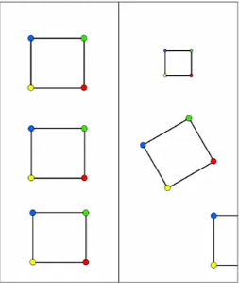
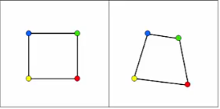
Affine Transformations
Non- Affine Transformations

Slide 20
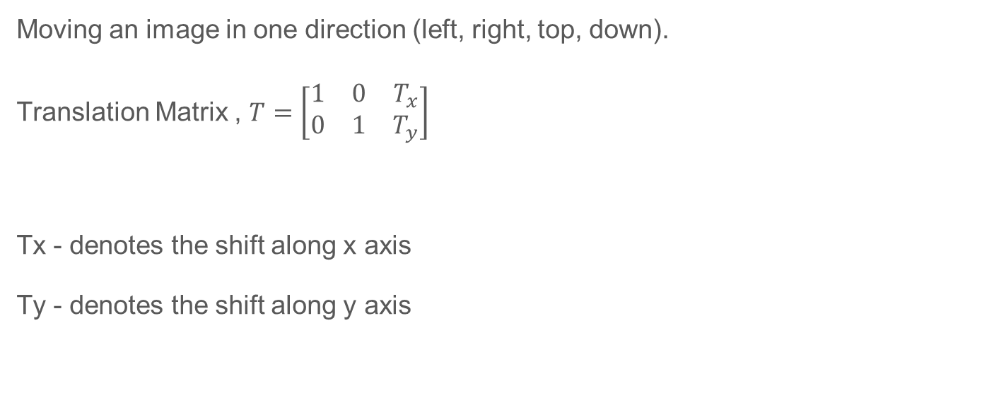
Image Translation
Moving an image in one direction (left, right, top, down).
Translation Matrix , $T=\left[\begin{matrix}1 & 0 & T_{x} \\ 0 & 1 & T_{y}\end{matrix}\right]$
Tx - denotes the shift along x axis
Ty - denotes the shift along y axis

Slide 21
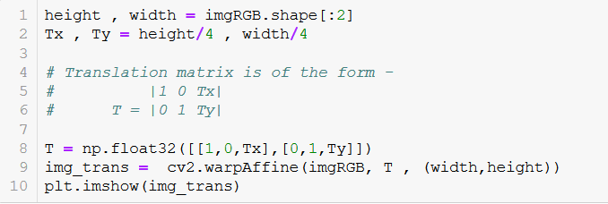
Image Translation

Slide 22
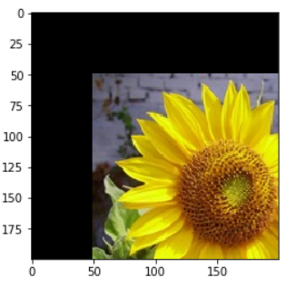
Image Translation
Input Image
Translated Output Image

Slide 23
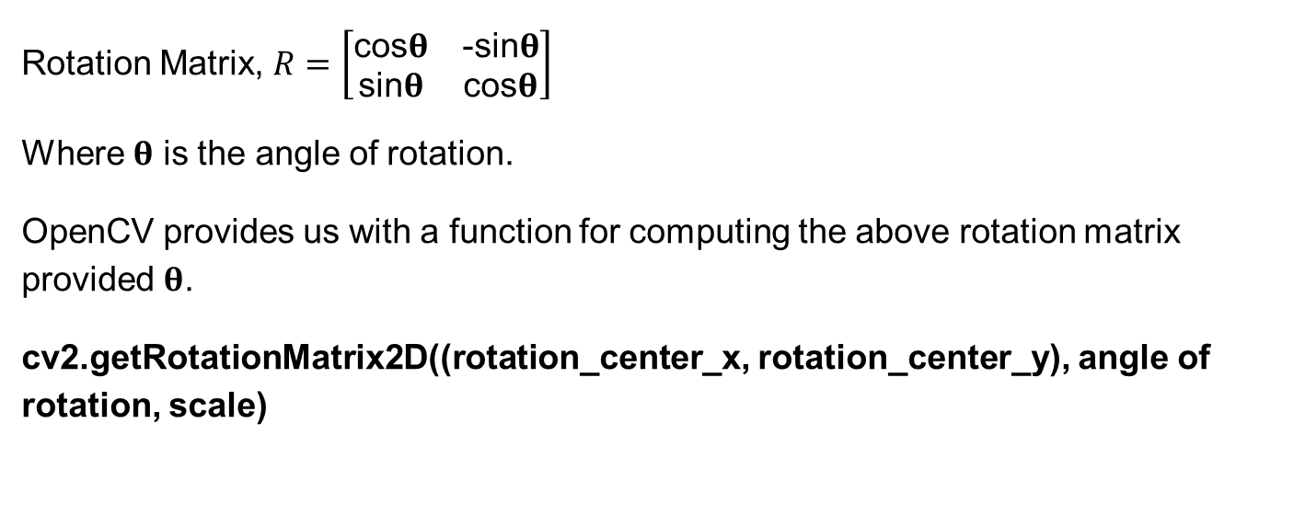
Image Rotation
Rotation Matrix, $R=\left[\begin{matrix}\text{cos}\text{θ} & \text{−}\text{sin}\text{θ} \\ \text{sin}\text{θ} & \text{cos}\text{θ}\end{matrix}\right]$
Where 𝛉 is the angle of rotation.
OpenCV provides us with a function for computing the above rotation matrix provided 𝛉.
cv2.getRotationMatrix2D((rotation_center_x, rotation_center_y), angle of rotation, scale)

Slide 24
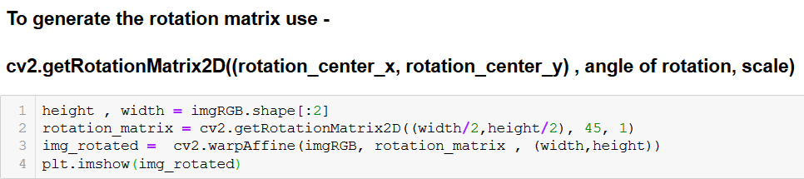
Image Rotation

Slide 25
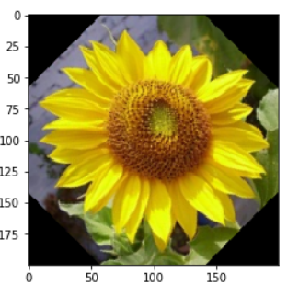
Image Rotation
Input Image
Image Rotated by 45 degrees

Slide 26
Image Scaling
What is Interpolation?
Interpolations means to estimate the value of unknown pixels by making use of the known image pixels. It is required when we resize an image.
cv2.INTER_AREA - Good for Shrinking an image
cv2.INTER_LINEAR - Good for Zooming an image

Slide 27
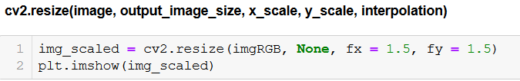
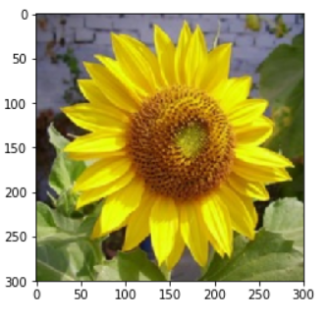
Image Scaling

Slide 28
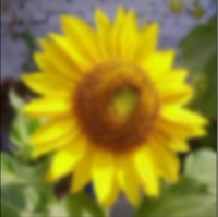
Image Smoothing
Input Image
Output Image

Slide 29
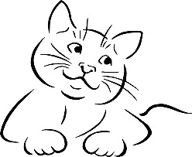
Edges in an Image
Why edges are important?
Edges preserves a lot of image even though a lot of detail is missing.

Slide 30
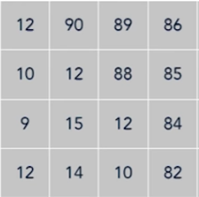
Edge Detection
Basic Intuition is to look for neighborhood with strong magnitude of change.

Slide 31
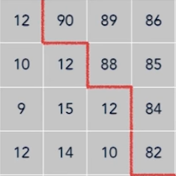
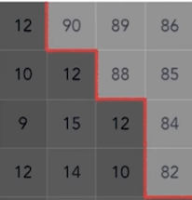
Edge Detection
Basic Intuition is to look for neighborhood with strong magnitude of change.

Slide 32
Canny Edge Detection Algorithm
Applies Gaussian Blurring
Finds intensity gradient of an image
Apply non- maximum suppression (i.e. removes pixels that are not edges)
Hysteresis - Applies threshold (i.e. if a pixel is within the upper and lower thresholds, it is considered an edge)

Slide 33

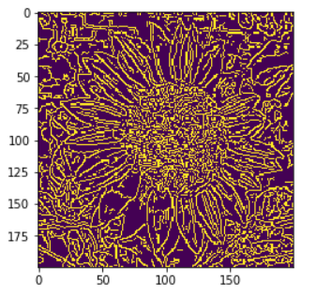
Edge Detection

Slide 34


Image Thresholding
Grayscale Image
Binary Image

Slide 35
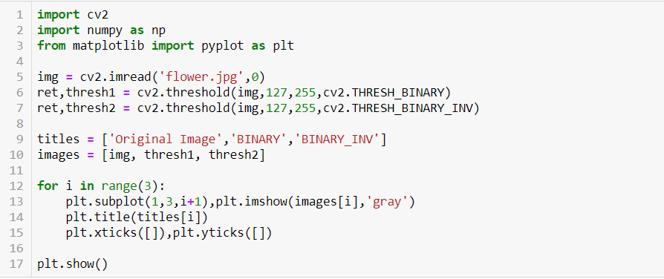
Image Thresholding

Slide 36
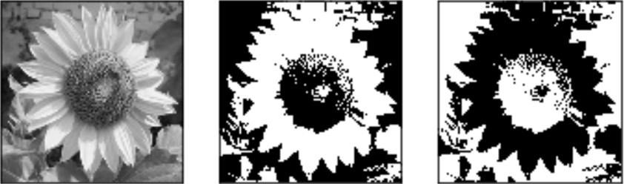
Image Thresholding
Input Image
Binary
Binary-INV

Slide 37
Extracting Key Points from an Image
Key points - The points in an image that are invariant to Image Transformations (rotation, scaling, translation etc.).
Even after transforming an image we will be able to find the same key points in the modified as well as original image.
Use cases - Image Matching, Panorama stitching etc.

Slide 38
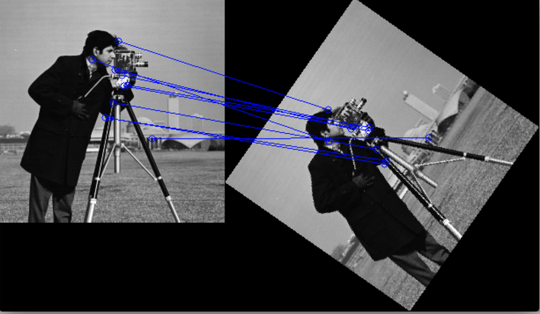

Slide 39
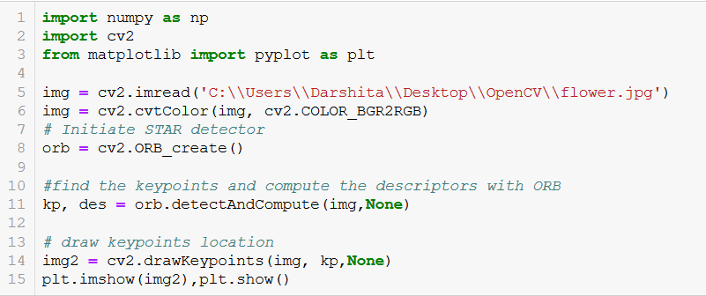
ORB (Oriented Fast Rotated Brief)

Slide 40
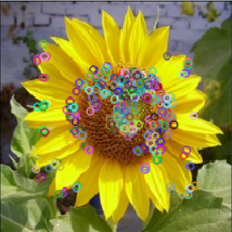
ORB Feature Extractor

Slide 41
Panorama Stitching
Step 1 - Detect the key points in both the input images.
Step 2 - Match Keypoints between the two images to be stitched.
Step 3 - Stitch the two images if they have matching key points otherwise the images cannot be stitched.

Slide 42
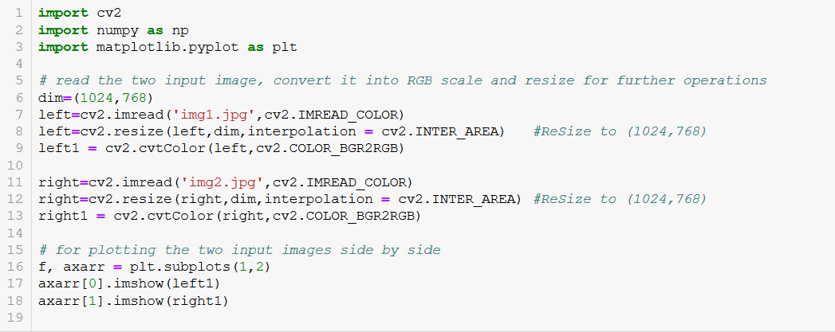
Panorama Stitching

Slide 43
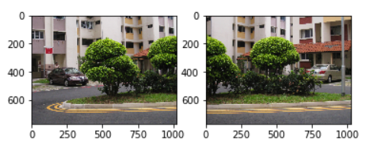
Panorama Stitching

Slide 44
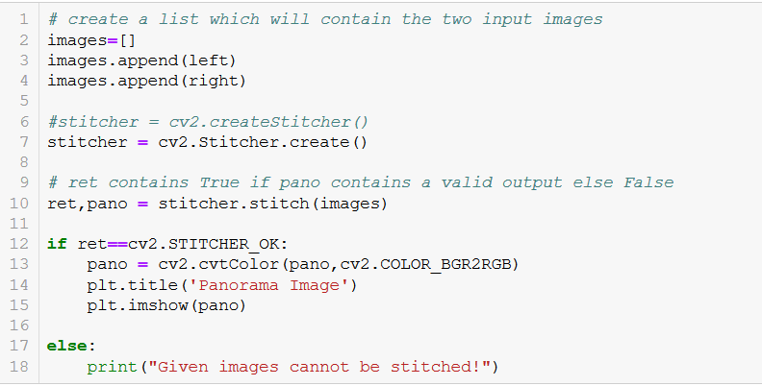
Panorama Stitching

Slide 45
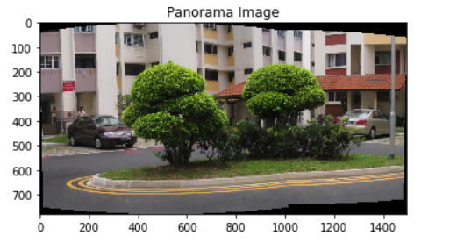
Panorama Stitching

Slide 46
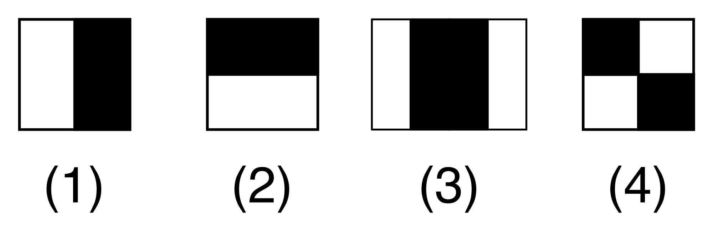
Face and Eye Detector
Haar Cascade Classifier –
A machine learning based object detection method that makes use of Haar features to identify objects in an image.

Slide 47
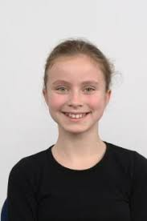
Face and Eye Detector
Haar cascade classifiers are trained by using lots of positive and negative examples.
For detailed explanation of Haar Cascade classifiers please refer this paper
Negative Example
Positive Example

Slide 48
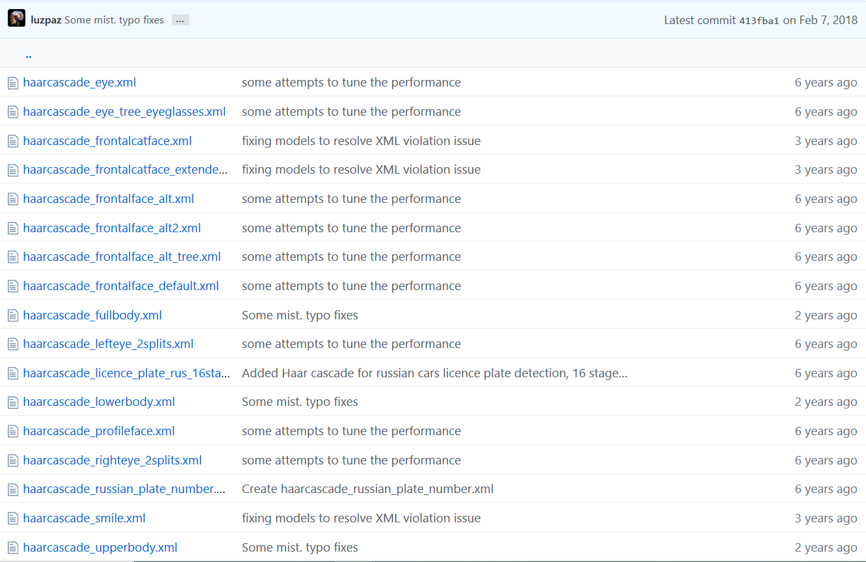
Link to the repo!

Slide 49
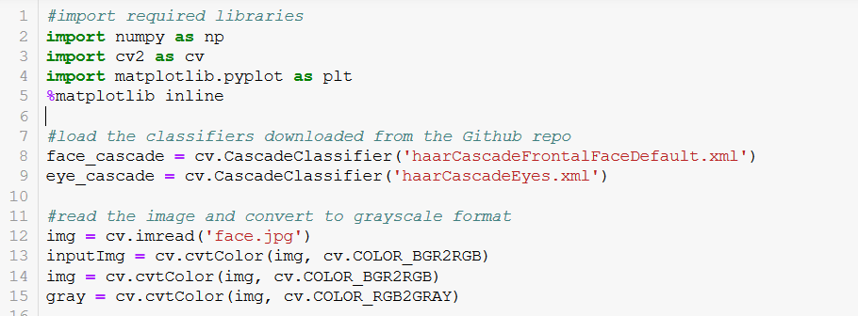
Face and Eye Detector

Slide 50
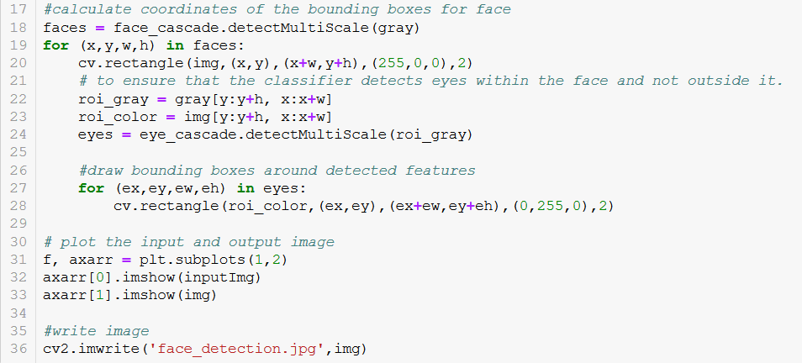
Face and Eye Detector

Slide 51
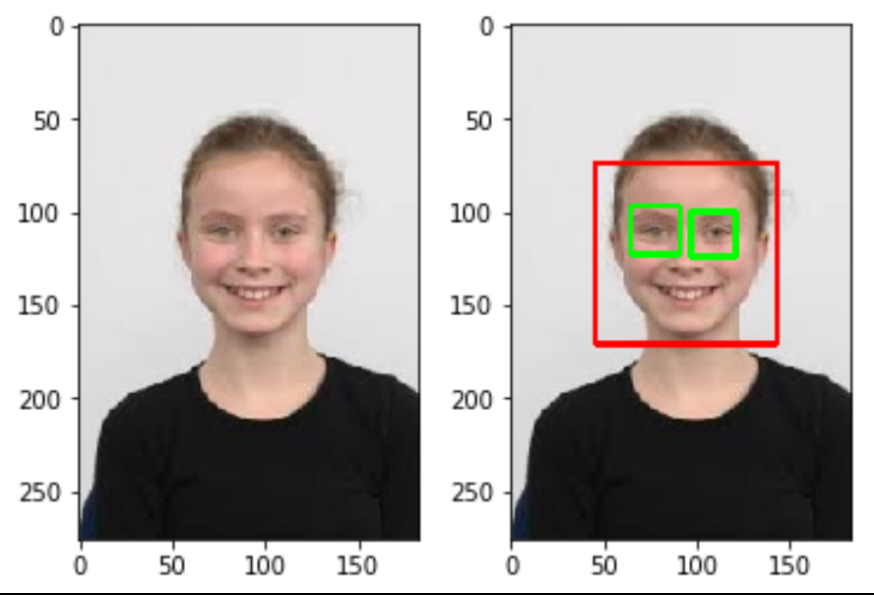
Face and Eye Detector

Slide 52
References
https://opencv-python-tutroals.readthedocs.io/en/latest/py_tutorials/py_setup/py_intro/py_intro.html#intro
https://www.udacity.com/course/computational-photography--ud955
https://www.udemy.com/course/master-computer-vision-with-opencv-in-python/learn/lecture/5860508#overview
https://www.pyimagesearch.com/
https://stackoverflow.com/questions/20259025/module-object-has-no-attribute-drawmatches-opencv-python/26227854#26227854
GitHub Repo link containing the workshop material -
https://github.com/darshitajain/Introduction-to-OpenCV

Slide 53
Thankyou !

